Slide 1
Algorithms: Space & Time Trade-Offs
For: CSCI 163A / COEN 179
By: Navid Shaghaghi

Slide 2
Introduction
Things which matter most must never be at the mercy of things which matter less.
—JohannWolfgangvonGo ̈ethe(1749-1832)
Basic Idea:
If time is at a premium, then we can store values in memory for future usage
If space is at a premium, then we can do the calculations every time we need the values

Slide 3
Varieties of Space-for-Time Algorithms
Input enhancement / Preprocessing / Preconditioning — preprocess the input in whole or in part and store the additional information obtained to accelerate solving the problem afterwards
Counting methods for sorting
String searching algorithms such as Boyer-Moore and HorsPool
Prestructuring — preprocess the input to make accessing its elements easier
Hashing
Indexing Schemes (e.g., B-trees)

Slide 4
Side Notes
Time and space do not have to compete with each other in all design situations. In fact, they can align to bring an algorithmic solution that minimizes both the running time and the space consumed when an algorithm uses a space-efficient data structure to represent a problem’s input, which leads, in turn, to a faster algorithm.
Space-time trade-offs is also important in data compression, however, in data compression, size reduction is the goal rather than a technique for solving another problem.

Slide 5
Comparison Counting Sort
Count the total number of elements smaller than this element and record the results in a table. These numbers will indicate the positions of the elements in the sorted list
Example: if the count is 10 for some element, it should be in the 11th position (with index 10, if we start counting with 0) in the sorted array.

Slide 6
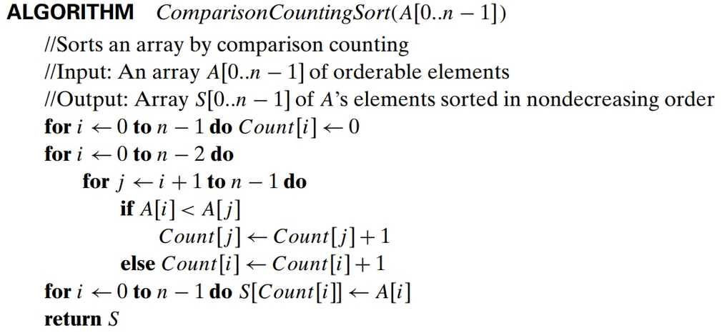
Algorithm

Slide 7
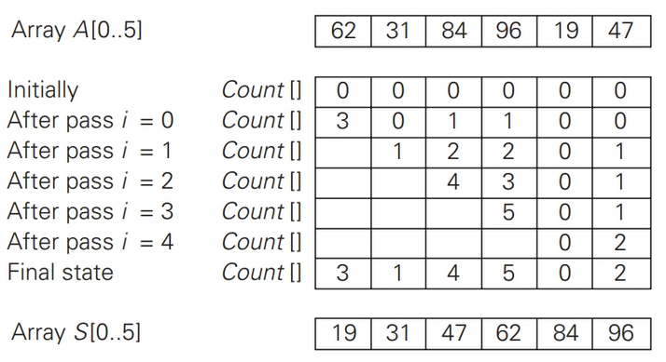
Example

Slide 8
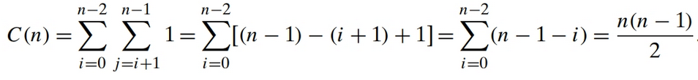
Efficiency
On the negative side, the algorithm conducts the same number of key comparisons as selection sort and in addition uses a linear amount of extra space.
On the positive side, the algorithm makes the minimum number of key moves possible, placing each of them directly in their final position in a sorted array.

Slide 9
So, where is it useful?
The counting idea does work productively in a situation in which elements to be sorted belong to a known small set of values.
For example if we have to sort a list whose values can be either 0 or 1. we can scan the list to compute the number of 0’s and the number of 1’s in it and then, on the second pass, simply make the appropriate number of the first elements equal to 0 and the remaining elements equal to 1.

Slide 10
Distributed Counting Sort
Definition: Distribution values – Values that indicate the proper positions for the last occurrences of their elements in the final sorted array.
Notes:
If we index array positions from 0 to n − 1, the distribution values must be reduced by 1 to get corresponding element positions.
It is more convenient to process the input array right to left.

Slide 11
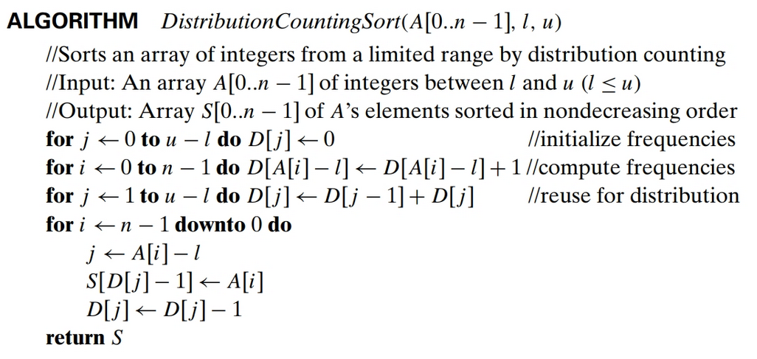
Algorithm

Slide 12

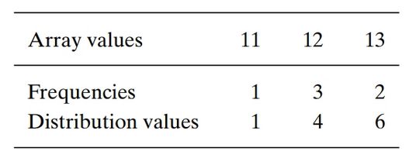
Example

Slide 13
Example
Process:
The last element is 12, and, since its distribution value is 4, we place this 12 in position 4 − 1 = 3 of the array S that will hold the sorted list.
Then we decrease the 12’s distribution value by 1 and proceed to the next (from the right) element in the given array.

Slide 14
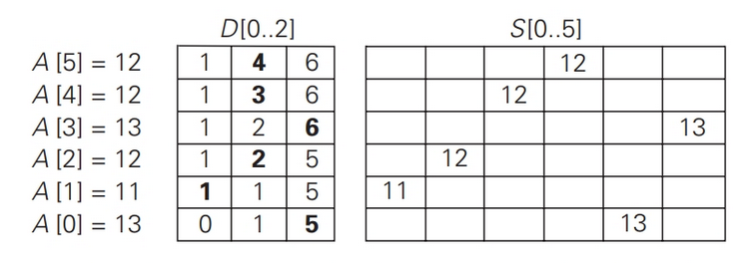
Example

Slide 15
Time Efficiency
Assuming that the range of array values is fixed,
this is obviously a linear algorithm
because it makes just two consecutive passes through its input array A.
T(n) = T_{Counting}(n) + T_{sorting}(n)
T_{counting}(n) ∈ Θ(n)
T_{sorting}(n) ∈ Θ(n)
So,
T(n) ∈ Θ(n) + Θ(n) = Θ(2n) ≈ Θ(n).

Slide 16
B-Trees
A principal device in organizing large data sets is an index, which provides some information about the location of records with indicated key values.
For data sets of structured records (as opposed to “unstructured” data such as text, images, sound, and video), the most important index organization is the B-tree, introduced by R. Bayer and E. McGreight

Slide 17
Definitions
Degree of B-Tree(Min/Max): the number of items in each node
Order of B-Tree: the number of children each node can have

Slide 18
Some key properties of B-Trees
A B-tree of order m ≥ 2 must satisfy the following structural properties:
The root is either a leaf or has between 2 and m children.
Each node, except for the root and the leaves, has between ⌈m/2⌉ and m children (and hence between ⌈m/2⌉ − 1 and m − 1 keys).
The tree is (perfectly) balanced, i.e., all its leaves are at the same level

Slide 19
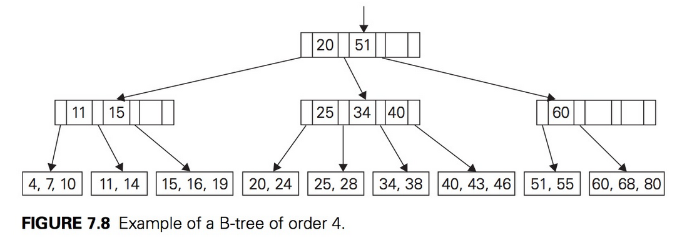
Example

Slide 20
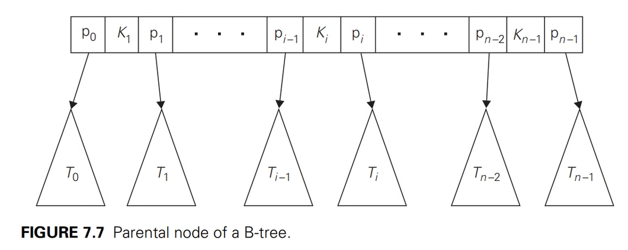
Each node

Slide 21
B-Tree Details
See my CSCI 61 slide set on B-Trees

Slide 22
Notes
There are other algorithms for implementing insertions into a B-tree.
Examples:
To avoid the possibility of recursive node splits, we can split full nodes encountered in searching for an appropriate leaf for the new record.
To avoid some node splits move a key to the node’s sibling.
For example, inserting 65 into the B-tree in Figure 7.8 can be done by moving 60, the smallest key of the full leaf, to its sibling with keys 51 and 55, and replacing the key value of their parent by 65, the new smallest value in he second child. This modification tends to save some space at the expense of a slightly more complicated algorithm.

Slide 23
Searching in a B-Tree
Starting with the root, we follow a chain of pointers to the leaf that may contain the search key.
Then we search for the search key among the keys of that leaf.
Note: since keys are stored in sorted order, at both parental nodes and leaves, we can use binary search if the number of keys at a node is large enough to make it worthwhile.

Slide 24
Time Analysis: Basic Operation?
It is not the number of key comparisons that we should be concerned about
Example:
When used for storing a large data file on a disk, the nodes of a B-tree normally correspond to the disk pages.
Since the time needed to access a disk page is typically several orders of magnitude larger than the time needed to compare keys in the fast computer memory, it is the number of disk accesses that becomes the principal indicator of the efficiency of this and similar data structures.

Slide 25
Time Analysis
How many nodes of a B-tree do we need to access during a search for a record with a given key value?
Height of the tree (h) plus 1.
So how do we estimate the height of a B-Tree?
Find the smallest number of keys a B-tree of order m and positive height h can have.

Slide 26
Finding the Height of a B-Tree
The root of the tree will contain at least one key.
Level 1 will have at least two nodes with at least ⌈m/2⌉ − 1 keys in each of them, for the total minimum number of keys 2(⌈m/2⌉ − 1).
Level 2 will have at least 2⌈m/2⌉ nodes (the children of the nodes on level 1) with at least ⌈m/2⌉ − 1 in each of them, for the total minimum number of keys 2⌈m/2⌉(⌈m/2⌉ − 1).
In general, the nodes of level i, 1 ≤ i ≤ h − 1, will contain at least 2⌈m/2⌉^{i−1}(⌈m/2⌉ − 1) keys.
Finally, level h, the leaf level, will have at least 2⌈m/2⌉^{h−1} nodes with at least one key in each.

Slide 27
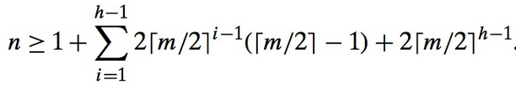


Finding the Height of a B-Tree
Thus, for any B-tree of order m with n nodes and height h > 0, we have:
Which reduces to:
Solving for h we get: which is in O(log n)

Slide 28
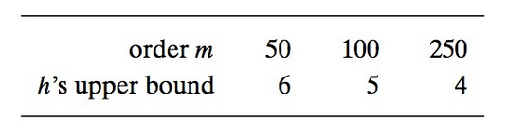
Example
Assume we have a file with n = 100 million records and we organize it in a B-Tree of order m. Then the height of the B-Tree will be:
Which is 1 less than the number of disk accesses needed to find the data we are looking for.

Slide 29
Final note on B-Tree Time Analysis
Searching, Insertion and Deletion in B-Trees are all of the same order.
Why?
Because we need to search before insertion or deletion
And searching determines the bound

Slide 30
Hashing
See slides 17 - 38 of “CSCI 61 Lecture 09 _ Searching” slide set. Ignore C++ implementation details and examples.
See slides 15 – 21 of the textbook’s chapter 07 Slide set.

Slide 31
Hashing vs. B-Trees
Asymptotic efficiency
Hashing: Θ(1) on Average and Θ(n) on very unlikely worst case
B-Tree: Θ(log n) in both Average and worst case.
Order Preservation

